Slide 1
Science with Dr. Christina Rahm We will get started shortly.

Slide 2
Medical Disclaimer:
The information provided is for educational purposes and is not intended as medical advice, or a substitute for the medical advice of a physician or other qualified health care professional. You should not use this information for diagnosing a health or fitness problem or disease. You should always consult with a doctor or other health care professional for medical advice or information about diagnosis and treatment.
Not to be used for sales or marketing purposes.
Notes:
The information provided is for educational purposes and is not intended as medical advice, or a substitute for the medical advice of a physician or other qualified health care professional. We do not aim to diagnose, treat, cure or prevent any illness or disease. You should always consult with a doctor or other health care professional for medical advice or information about diagnosis and treatment. The information in this presentation has not been evaluated by the Food & Drug Administration or any other medical body.

Slide 3
Dr. Christina Rahm CEO & Chief Science Officer

Slide 4
ISNS Case Study Presented by: Dr. Christina Rahm
International Science and Nutrition Society – CURARE CAUSAM – ISNS 2021

Slide 5
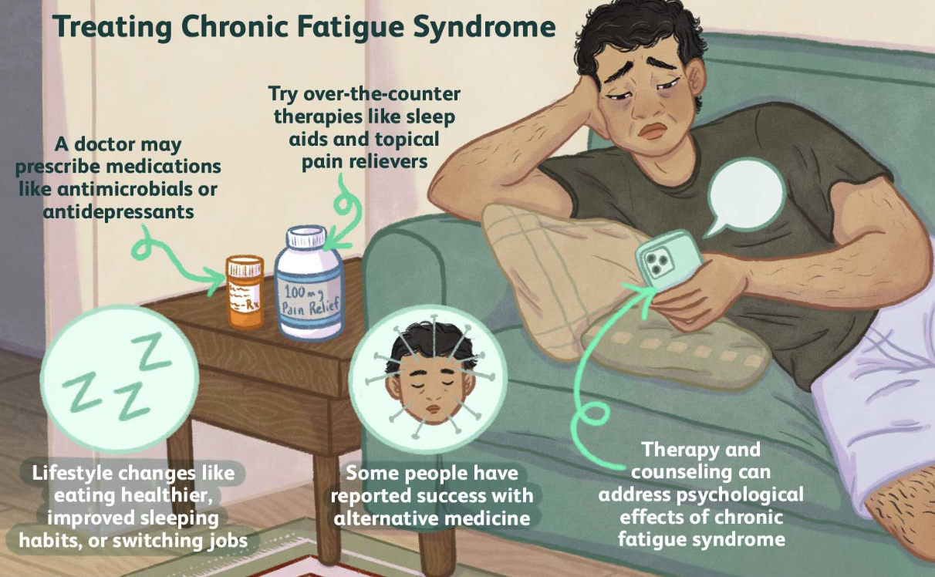
Chronic Fatigue/ ME
Chronic fatigue syndrome (CFS) is a chronic long-term illness that affects many-body systems. CFS is also known as myalgic encephalomyelitis/chronic fatigue syndrome (ME/CFS). ME/CFS causes inflammation in the brain and spinal cord, in addition to trigger points causing pain in the muscles.
The exertion of normal day-to-day activities will result in extended periods of bed rest for anyone suffering from ME/CFS. The most common age group is between 40 and 60 years old affecting adult women more often than adult men. However, ME/CFS can affect anyone in any age group including children and teenagers and may develop slowly over months or years. ME/CFS the condition may be exacerbated by a viral infection, toxic exposure, immunization, gastroenteritis, or trauma. ME/CFS is a complex illness with unknown etiology, difficult to diagnose, and no specific test and other diseases can cause similar symptoms.
International Science and Nutrition Society – CURARE CAUSAM – ISNS 2021

Slide 6
PROPRIETARY BLENDS LEGEND
Proprietary blend I: Silica, Vitamin C, and Trace Minerals
Proprietary blend II: N-acetyl L-tyrosine, Anhydrous Caffeine, L-theanine, Velvet Bean Seed, Pine Bark, Curcumin, and Vitamin D
Proprietary blend III: Black seed oil, Resveratrol, turmeric, Raspberry Ketones, Apple Cider Vinegar, Aloe Vera, and D-Ribose
International Science and Nutrition Society – CURARE CAUSAM – ISNS 2021

Slide 7
ISNS CASE STUDY I
Patient: Female
Age: 62-year-old
History: In 1989 she became sick and reported trouble sleeping. In the mid-90s developed adrenal fatigue and blood sugar issues. She had numerous blood test which were completely normal. She reported that after one hour of gardening she was in bed for six hours to recover and incapacitated the following week. Diagnosed with chronic fatigue in 2013, shortly after having some amalgam and teeth removal. Trouble with mental focus, anxious, and high strung.
Treatment/ Method: September 2020 started taking Proprietary blend 1, 4 drops B.I.D.
Results: After 2 months, she reported the following: food sensitivities abated, more energy, better focus and concentration, histamine intolerance alleviated, knee pain alleviated, and blood sugar stabilization.
She is due for a follow up.
International Science and Nutrition Society – CURARE CAUSAM – ISNS 2021

Slide 8
PROPRIETARY BLEND I SILICA/ZEOLITES, VITAMIN C , AND TRACE MINERALS
International Science and Nutrition Society – CURARE CAUSAM – ISNS 2021

Slide 9
VITAMIN C & CHRONIC FATIGUE
Vitamin C is a powerful energizer that helps the body get back on track by treating the disorder and eliminating the symptoms.
International Science and Nutrition Society – CURARE CAUSAM – ISNS 2021

Slide 10
Intravenous Vitamin C administration reduces fatigue in office workers: a double-blind randomized controlled trial
Sang-Yeon Suh, Woo Kyung Bae, Hong-Yup Ahn, Sung-Eun Choi, Gyou-Chul Jung, and Chang Hwan Yeom
Objective: In this study, 141 volunteers, aged 20 to 49-years-old, received 10 grams of vitamin C with normal saline intravenously, while the placebo group received normal saline only
Results: The study found the fatigue scores decreased in the vitamin C group after two hours and remained lower for one day. In addition, the trial led to higher plasma vitamin C levels and lower oxidative stress compared to the placebo group.
https://www.ncbi.nlm.nih.gov/labs/pmc/articles/PMC3273429/
International Science and Nutrition Society – CURARE CAUSAM – ISNS 2021

Slide 11
SILICA/ZEOLITES & CHRONIC FATIGUE
Common side effects of toxin and heavy metal exposure is brain fog, weight gain, autoimmune diseases, a weakened immune system, and fatigue.
International Science and Nutrition Society – CURARE CAUSAM – ISNS 2021

Slide 12
The Elimination of Heavy Metals from The Body
In a clinical trial with 33 volunteers, zeolite boosted the elimination of aluminum, arsenic, lead, mercury and other heavy metals. Participants who received liquid zeolite had significantly higher levels of these metals in their urine samples. Laboratory analysis confirmed that the results were due to detoxification of the body.
https://core.ac.uk/display/26508247
Studies in mice have shown that zeolite removes lead and protects the brain from oxidative damage to the metal. It reduced lead levels in rodent organs by up to 91%.
https://link.springer.com/article/10.1007/s12011-011-9278-4

Slide 13
TRACE MINERALS & CHRONIC FATIGUE
Some of the most obvious signs of mineral deficiency are anemia, irregular heartbeat, and fatigue. Sometimes chronic fatigue is the body’s way of communicating a deficiency in the concentration of trace elements.
Out of balance concentration of trace mineral can cause the body inability to allow for proper cell regeneration and adequate energy production.
Some of the key nutrients in the list of trace mineral salts include zinc, magnesium, and chronium.
International Science and Nutrition Society – CURARE CAUSAM – ISNS 2021

Slide 14
Lower serum zinc in Chronic Fatigue Syndrome (CFS): Relationships to immune dysfunctions and relevance for the oxidative stress status in CFS
Michael Maes, Ivana Mihaylova, and Marcel De Ruyter
Objective: In this study, researchers examined serum zinc concentrations in patients with chronic fatigue syndrome versus normal volunteers.
Results: It found that serum zinc was significantly lower in the CFS patients than in normal controls.
Serum zinc was significantly and negatively correlated to the increase in the alpha2 protein fraction and positively corelated to decreases in the expression of mitogen-induced CD69+ (a T cell activation marker) on CD3+ as well as CD3+CD8+ T cells.
https://www.sciencedirect.com/science/article/abs/pii/S0165032705003125
International Science and Nutrition Society – CURARE CAUSAM – ISNS 2021

Slide 15
THANK YOU FOR JOINING US TODAY!!!!
International Science and Nutrition Society – CURARE CAUSAM – ISNS 2021

